Slide 1


CDM Forecasting and Arbitration
Faurecia Clean Mobility
24.Feb.2023 Jiaxue LI
5acXjzUk

Slide 2
Contents
01
Introduction
02
Forecasting Example of Division and Plant
03
Accuracy & Statistical Conclusion
04
Future Questions

Slide 3


1. Introduction of CDM Forecasting
Objective:
Proposal a forecasting rate based on relationship between history Customer Demand and Actual Sales, to direct the future short–term and long-term sales for certain OEM and below Plants
Be able to compare the different customer behavior in a better way
Be able to have a short–term and long-term way to arbitrate customer demand and improve production plan arbitration process (PIC and PDP)
5acXjzUk

Slide 4
1. Introduction of CDM Forecasting
Available potential Data Source:
 |  | Detail Level | Time horizon | Sources
Forecast | EDI (Customer) | BG/ Div/ Plant/ Material/ Customer (Ship-to) | Weekly and Monthly | L37 BI report (Sunday) | Palantir (up -to-date data) | SAP (zppcd)
 | Magritte (Finance) | BG/ Div/ Plant | Monthly | Sarah
 | IHS | Market Research | Monthly | IHS Web
Actual Sales | Controlling | BG/ Div/ Plant/ Material/ Customer (Ship-to) | Weekly and Monthly | C35 BI report/ S10 BI report | Palantir (up -to-date data) | SAP (zqsd01)
 | Magritte (Finance) | BG/ Div/ Plant | Monthly | Sarah
Available potential Model:
Linear regression model – Y = m X + b
Time series forecasting model (Useful for ordered time series data) – AR, MA, ARIMA, SARIMA, SES, HWES
Relevant machine learning model – LSTM ...
5acXjzUk

Slide 5
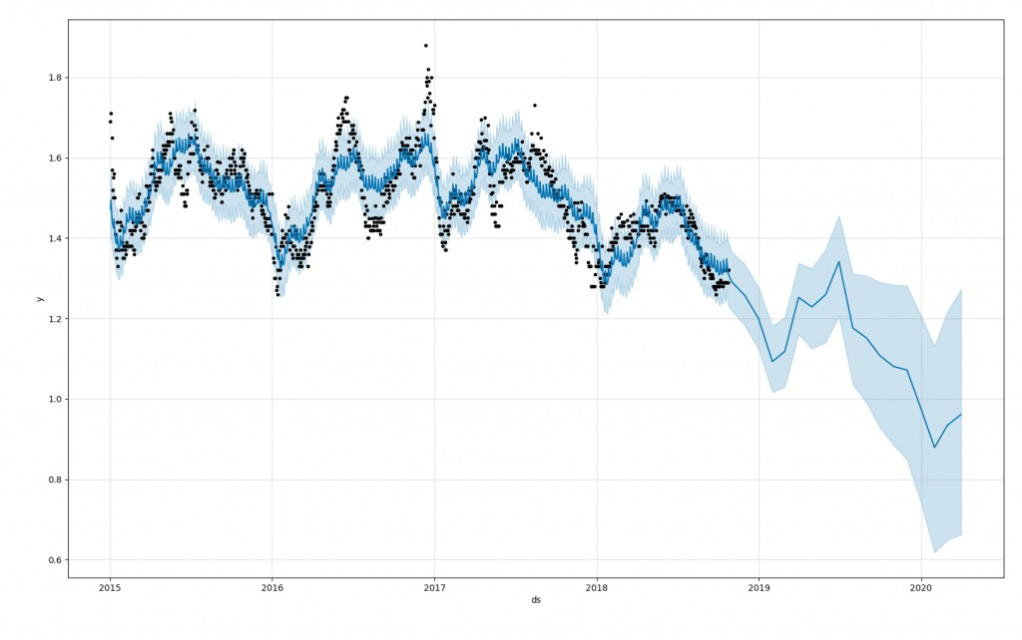
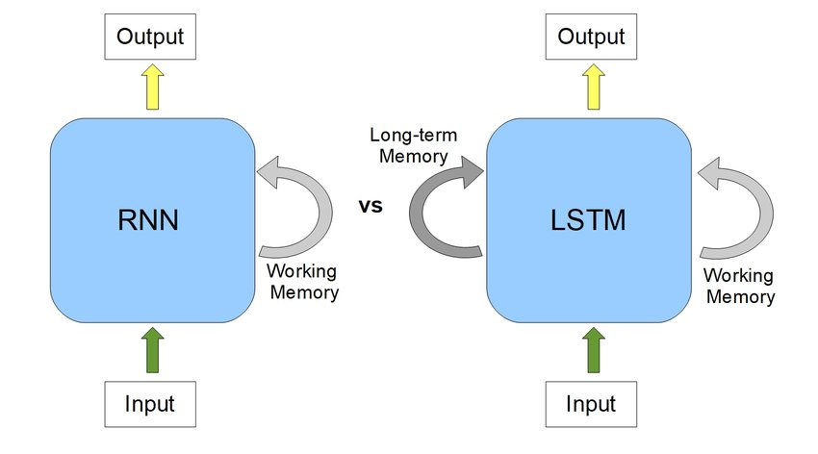
1. Introduction of CDM Forecasting
Introduction of available potential Model:
Time series forecasting model – AR, MA, ARIMA, SARIMA, SES, HWES
1) Definition:
Use historical data feature of seasonality or trend to make future observations
2) Applications:
Weather forecasting, stock price forecasting, retail forecasting
Possible machine learning model – LSTM
1) Definition:
Long short-term memory (LSTM) is an artificial neural network used in deep learning, which can learn long-term dependencies between time steps of data
It’s a better traditional machine learning model (RNN model)
2) Applications:
Sentiment analysis, language modeling, speech recognition, and video analysis
5acXjzUk

Slide 6
Contents
01
Introduction
02
Forecasting Example of Division and Plant
03
Accuracy & Statistical Conclusion
04
Future Questions

Slide 7
2.1 Selected Data Scope & Data Source for Division and Plant
BG Scope | FCM
Customer Scope | Stellantis
Division Scope | Europe Division
Data Source & Time Scope | S10: 2021 W48 – 2023 W07 (64 weeks) L37/EDI: 2021 W48 – 2023 W07 (64 weeks)
Forecasting & Arbitration level | Upper level: Per Customer/Division, for example Stellantis Europe Lower level: Per Customer/Plant, for example Stellantis Terni, Stellantis Pisek
5acXjzUk

Slide 8
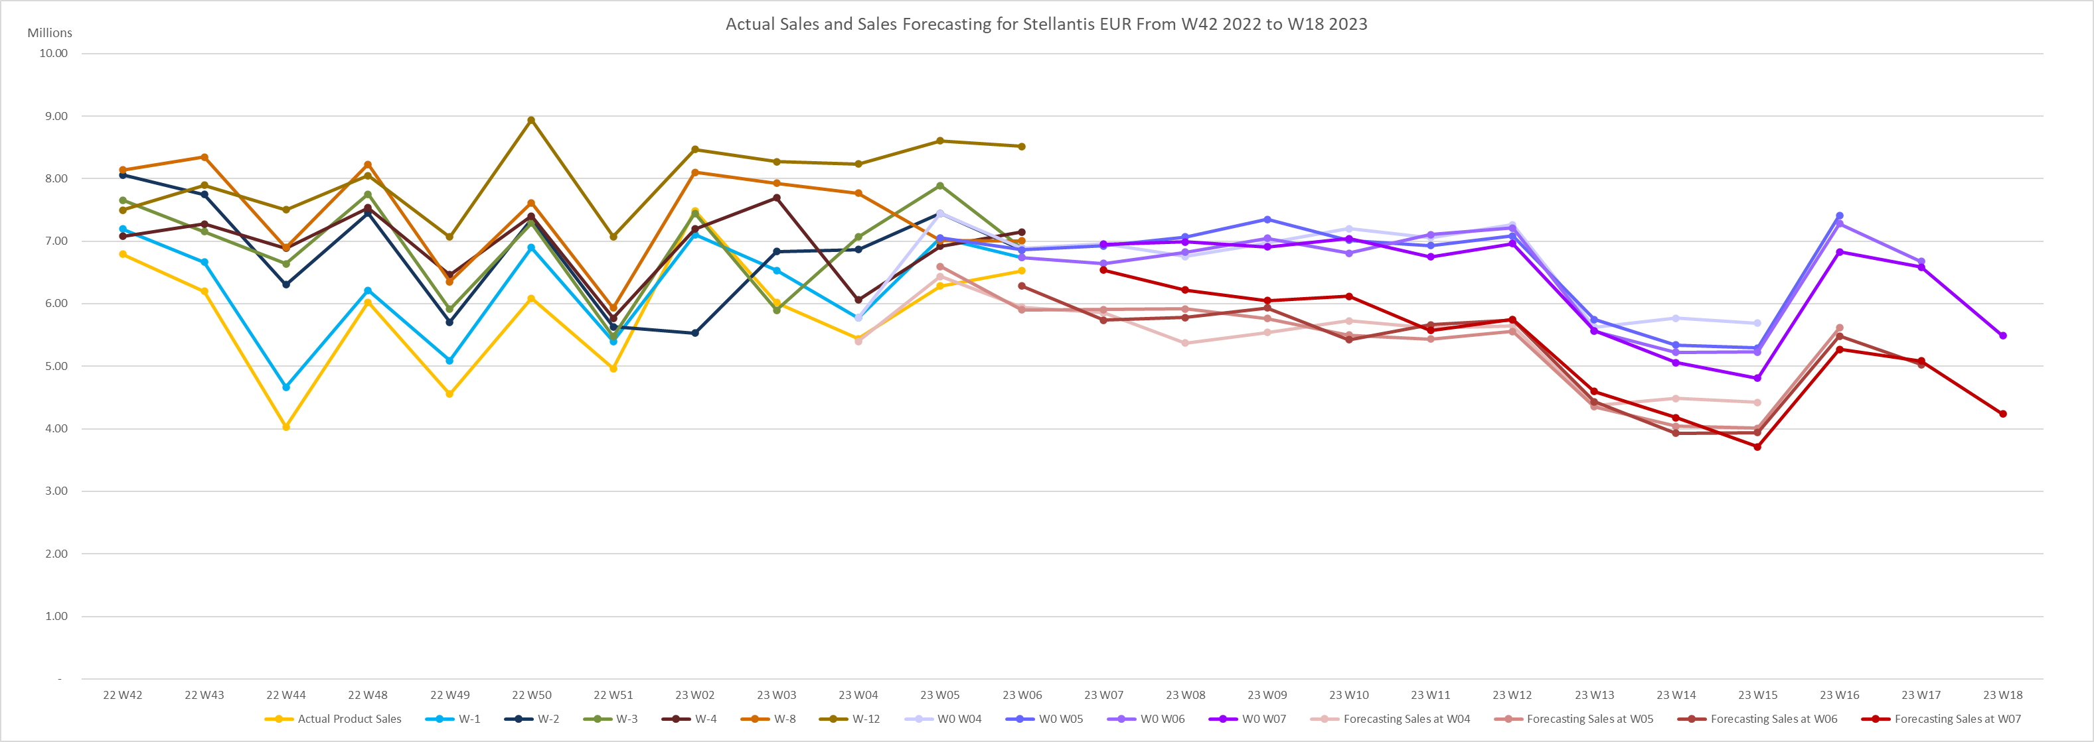
2.2 Forecasting results for Stellantis Europe Division
Example for Stellantis Europe Sales prediction in 2023 W04, W05, W06, and W07
WoW EDI evolution
WoW EDI evolution
WoW forecasting result
EDI W-3 Accuracy | EDI W-2 Accuracy | EDI W-1 Accuracy | Forecasting W-3 Accuracy | Forecasting W-2 Accuracy | Forecasting W-1 Accuracy | Average progress %
79.7% | 83.4% | 92.8% | 91% | 94% | 96.9% | 10.4%
Principle: Apply on future EDI the historical customer demand behavior
The Actual Sales value is closer the Red Forecasting results than EDI week by week
5acXjzUk

Slide 9
2.3 Logic for Stellantis Europe Division Forecasting
Delete the regular drops in a year, January and August, so exclude W30 W31 W32 and W52 W01 for each of years.
Data clean is mandatory
Methodologies: dropping detection (Sales is -50% vs. Sales W-2/W+2 )

Slide 10
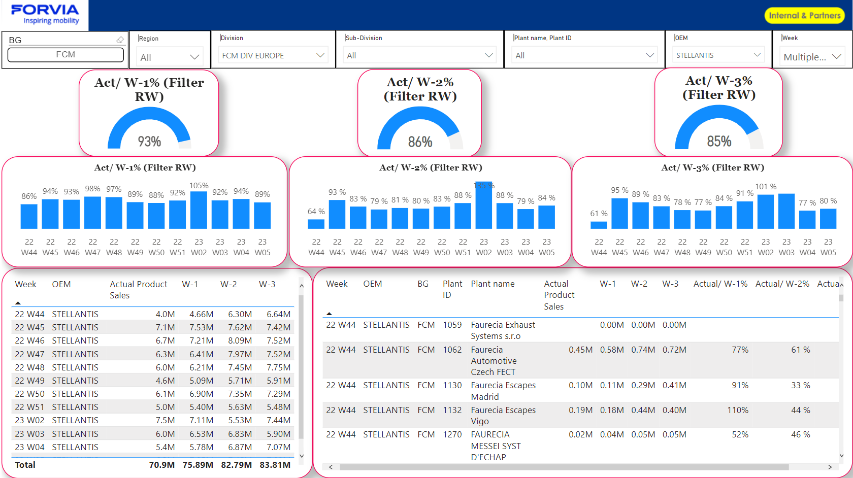
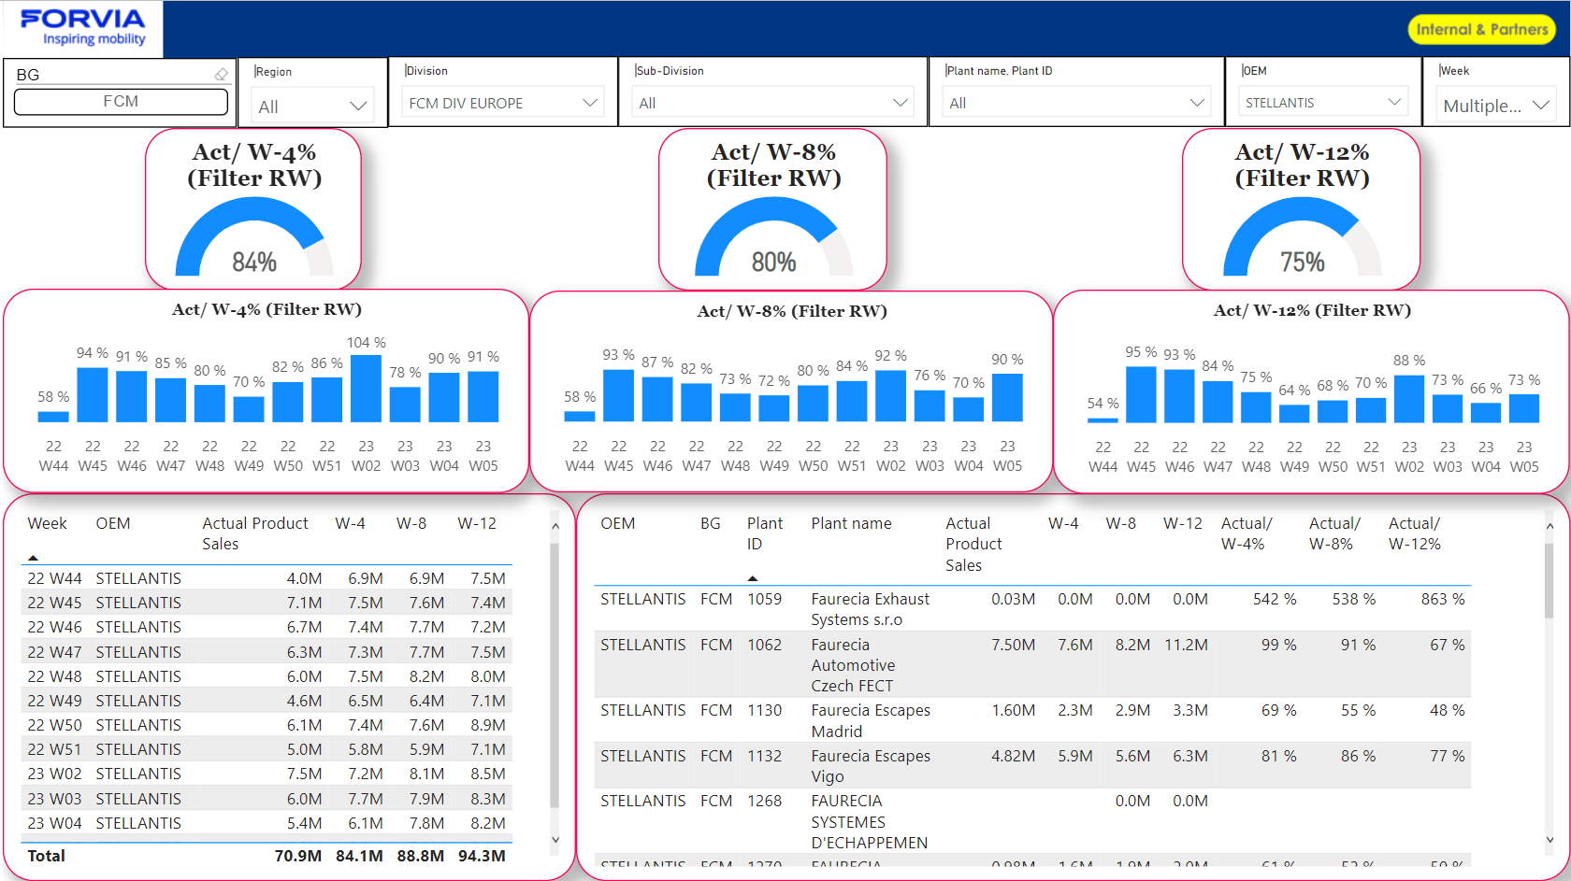
2.3 Logic for Stellantis Europe Division Forecasting
2. Principle:
Based on average of previous rolling weeks (12), EDI accuracy is defined, called “customer demand behavior”
Apply the customer demand behavior defined per plant/ship-to on corresponding future EDI
Weekly EDI Accuracy in Power Bi
5acXjzUk

Slide 11
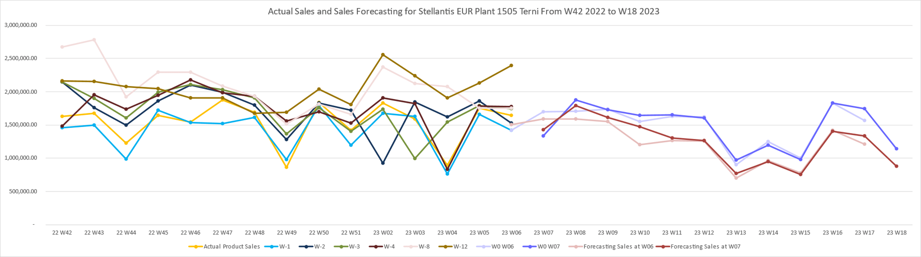
2.4 Forecasting results for Stellantis Plant example #1
Apply the same logic for the Plant level:
Example for Stellantis Plant 1505 Terni Sales prediction in W06 and W07
WoW EDI evolution
WoW forecasting result
The Red Forecasting accuracy is better than EDI (91.3% vs. 86.2%)
5acXjzUk

Slide 12
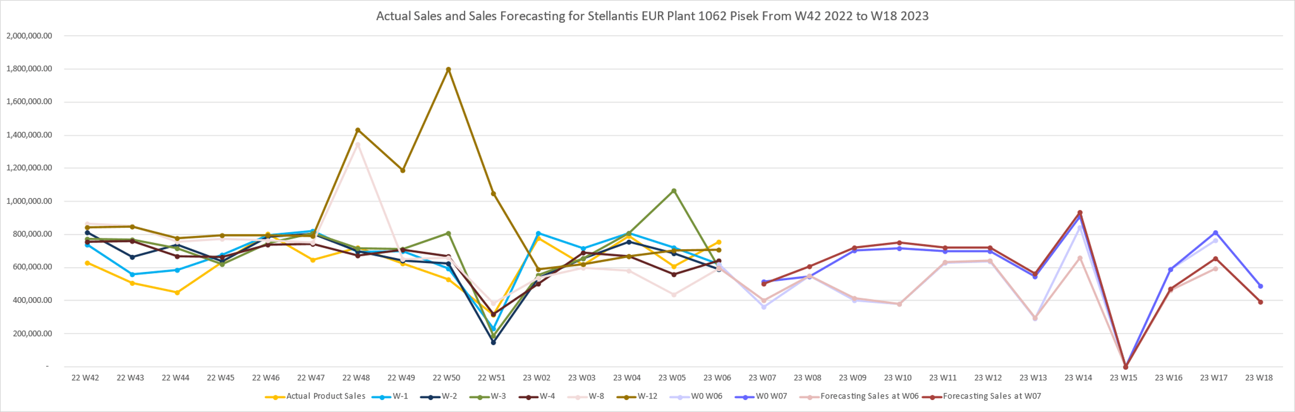
2.4 Forecasting results for Stellantis Plant example #2
Apply the same logic for the Plant level:
Example for Stellantis Plant 1062 Pisek Sales prediction in W06, and W07
WoW EDI evolution
WoW forecasting result
The Red Forecasting accuracy is worse than EDI accuracy (78.7% vs 82.1%)
In the logic for the Plant Level, the model performance need to be tested more times
5acXjzUk

Slide 13
Contents
01
Introduction
02
Forecasting Example of Division and Plant
03
Accuracy & Statistical Conclusion
04
Future Questions

Slide 14
3.1 Accuracy for Stellantis Europe Division Forecasting
Accuracy comparation for the Forecasting of W04, W05, W06 examples
EDI Accuracy | EDI W-12 Accuracy | EDI W-8 Accuracy | EDI W-4 Accuracy | EDI W-3 Accuracy | EDI W-2 Accuracy | EDI W-1 Accuracy | Average progress in only EDI %
 | 60.4% | 79.4% | 89.7% | 79.7% | 83.4% | 92.8% | 9.8%
Forecasting Accuracy |  |  |  | Forecasting W-3 Accuracy | Forecasting W-2 Accuracy | Forecasting W-1 Accuracy | Average progress in only Forecasting %
 |  |  |  | 91% | 94% | 96.9% | 3.2%
Progress by weeks |  |  |  | 14.2% | 12.7% | 4.3%
Average progress Forecasting vs. EDI |  |  |  | 10.4%
The accuracy of EDI and the accuracy of Forecasting are both better when using the closer week results
Forecasting results is better than EDI values in each of weeks
The forecasting result is better than we only apply EDI, average progress is 10.4%
5acXjzUk

Slide 15
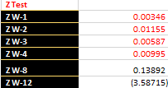
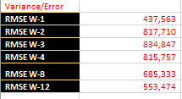
3. Statistical test for Stellantis Europe Division Forecasting
In order to validate the accuracy of the model, Z-test done on 42 past weeks data
Z-Test: Compare the error of averages (Actual and Forecasting)
In 95% of time, the average of actual and forecasting value is close to each other
The forecasting results is good
Z < 1.96 means The correct rate of "the two means are not significantly different" is higher than 95%
RMSE (Root-mean-square deviation): Compare the error of extreme value
Average of weekly Stellantis EUR Sales is €5,397,739,
But the extreme error are under € 900,000 and far smaller than €5,397,738.7,
Then, the extreme error are acceptable,
The forecasting results is good
After Z-test and comparation of RMSE, the forecasting logic is confident enough to be used
5acXjzUk

Slide 16
Contents
01
Introduction
02
Forecasting Example of Division and Plant
03
Accuracy & Statistical Conclusion
04
Future Questions

Slide 17
Future Work Plan
Testing different division sales for Stellantis, and different OEM sales for Europe to compare the results. (need to be transferred to Adam and Samir)
Apply the same logic or develop another one for the Plant Level, remember there will be 0 sales in plant on some weeks
Starting use IHS to combine with EDI prediction result
The optimization direction is determined by the results of the above 3 points
5acXjzUk

